Slide 1


HOTEL BOOKING ANALYSIS
SWATHI D – AF0380796
Notes:
To use this title animation slide with a new image simply 1) move the top semi-transparent shape to the side, 2) delete placeholder image, 3) click on the picture icon to add a new picture, 4) Move semi-transparent shape back to original position, 5) Update text on slide.

Slide 2

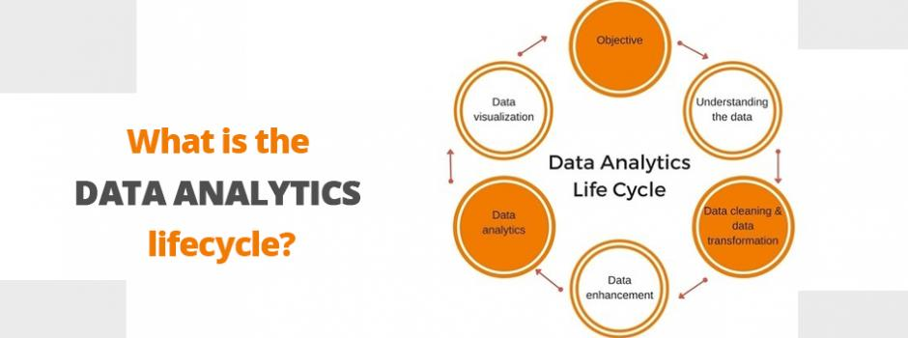
Data Analysis Lifecycle

Slide 3
WHAT ?
What is Hotel Booking Analysis ?

Slide 4
WHY ?
Why Hotel Booking Analysis ?
Revenue Management
Booking Patterns and Trends
Market Segmentation
Guest Preferences and Feedback
Actionable insights and stratergies

Slide 5
Analyzing hotel booking trends to optimize revenue and enhance guest satisfaction.
PROBLEM STATEMENT
!

Slide 6
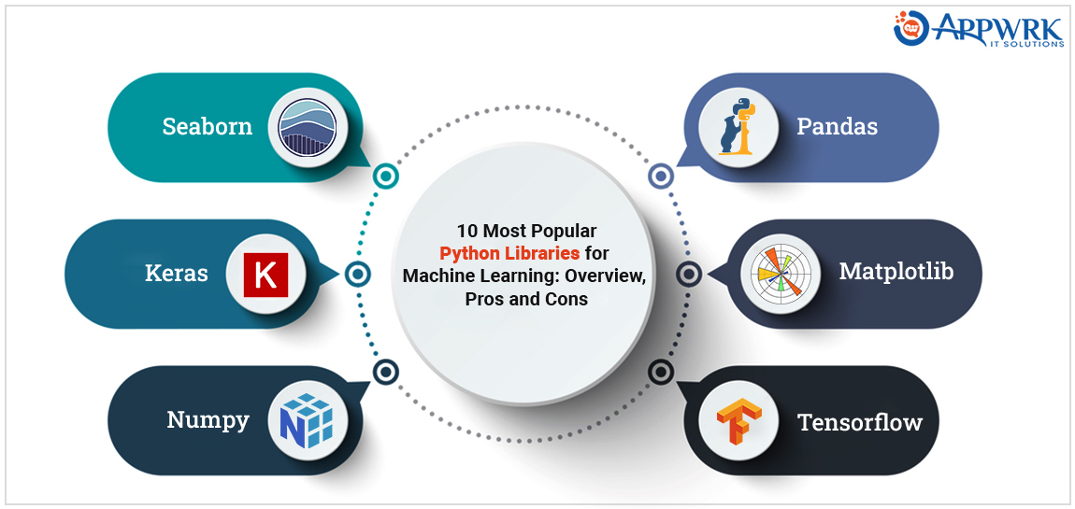
Technologies used Python

Slide 7
Processor: Intel Core i5 or equivalent (minimum), Intel Core i7 or higher (recommended)
RAM: 8 GB (minimum), 16 GB or more (recommended)
Storage: 256 GB SSD (minimum), 512 GB SSD or more (recommended)
Graphics: Integrated graphics for basic visualization, dedicated GPU for more intensive visualizations
Display: Full HD monitor (1920x1080 resolution) or higher
Internet Connection: Stable internet connection for downloading datasets and libraries
Hardware Requirements

Slide 8
Operating System:
Windows 10 or higher
macOS 10.14 (Mojave) or higher
Linux (any modern distribution)
Programming Languages:
Python 3.6 or higher
Python Libraries:
pandas: For data manipulation and analysis.
SOFTWARE REQUIREMENTS

Slide 9
Summary
By analyzing hotel booking data and understanding cancellation patterns, the project concludes that hotels can take effective steps to reduce cancellations and increase revenue. The findings suggest practical measures such as offering early booking discounts, longer stay promotions, and direct booking incentives, which can help hotels mitigate cancellations and enhance their financial performance.
Notes:
Tip:
When using complex image as full-bleed background add a transparency (70%-90%) fill layer to give contrast to text.

